Slide 1
EECD Capital Program March 25, 2021
Presentation
by
Director Educational Facilities and Pupil Transportation Branch

Slide 2
EECD Capital Planning Process
General:
Capital Program Components
Responsibilities
Timelines
Prioritisation process
Meeting Outcomes
- Understanding roles
- Awareness of process
- Present situation

Slide 3
Types of Projects
Major Capital
$1.0M or more
Multi-year
Specific Treasury Board(TB) approval
Capital Improvement
Less than $1.0M
Typically completed in a year
TB approves annual funding envelop
Pan-provincial programs
District allocation

Slide 4
Responsibilities – Capital Program
DEC Responsabilities
District requirements
Major Capital
Capital Improvements
Scope of projects
EECD Responsibilities
Develop provincial priority list
Recommend capital budget
Coordinate approved budget with district
GNB approves
Projects
Budget allocations

Slide 5
Timelines (Policy 409/TB Process)
District conducts analysis/decision (Jan-May)
May 31 district submission
Major capital priorities
Capital Improvement priorities
EECD conducts provincial analysis (Jun-Sep)
Develop project files
Prioritisation process (score projects)
Prepare submission
Snr mgt presentation
Ministerial presentation
Submit (fall/November)
TB presentation
GNB Capital Program approved (December/Jan)

Slide 6
Prioritisation Process
The challenge: How to prioritise different types of projects in a defensible manner.
Solution: QBL – a tool to aid staff in project prioritisation, based on objective analysis at strategic level
Data driven
Respect Education Act
Support to pedagogical requirements
Responsive to GNB priorities
Provincial perspective

Slide 7
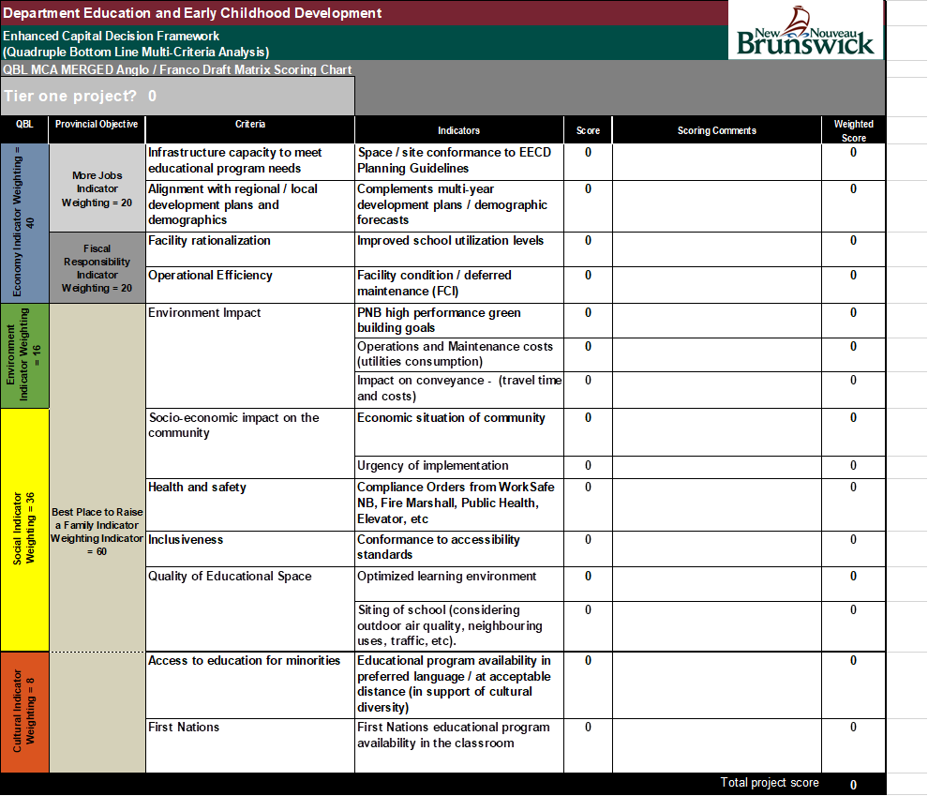
QBL MCA matrix

Slide 8
Capital Planning Impacts
Government Direction
Indicator adjustments (govt focus)
Changing criteria
Must do, Can be deferred, Do not proceed
2019-20, 9 projects deferred
Annual budget allocation
Policy change (french immersion eg.)
Population changes (new projects)
Forecasting tools limited
1000 declining to 1000 increasing in four years

Slide 9
Consistency
Process for decision advice consistent
Criteria more agile
GNB priorities
Shifting social requirements
Changing pedegogical models
Department advises government
QBL is a tool to aid in decision making
GNB makes its decisions
Project ranking
Affected by data changes
Other project status

Slide 10
Questions

